Slide 1

Resilient Food Supply Chain Design
Stanny Lemos
NUID: 001388497

Slide 2

Project Problem
The spread of the COVID-19, is being felt globally across operations in ways that are difficult to model and assess.
Aim to design a food supply chain that is resilient enough to ensure business operations continuity in the event of risks or disruptions.
A bi-objective mixed-integer programming formulation for resilient food supply chain design is proposed to minimize the procurement costs and total supply chain lead time.
NSGA-II are proposed algorithm to solve and identify an efficient configuration of the system in the case of disruption, with scope further use of Ant Colony Optimization which is more effective in solving multi-objective optimization problems.

Slide 3
Need for Metaheuristic Approach
Problem
Metaheuristic Solution

Slide 4
Literature Review
Resilient food supply chain design: Modelling framework and metaheuristic solution approach
Case study on sustainable supply chain network design
Sustainable Agro-food supply chain design using two-stage hybrid multi-objective decision-making approach
A multi-objective sustainable hub location-scheduling problem for perishable food supply chain

Slide 5
Literature Review 1 - Resilient food supply chain design: Modelling framework and metaheuristic solution approach
1. Problem
2. Bi-objective mixed-integer programming formulation
3. Developed model
4. Future works

Slide 6
Literature Review 2 – A multi-objective sustainable hub location-scheduling problem for perishable food supply chain
1. Aim
2. Problem
3. Research Direction

Slide 7
Literature Review 3 - Sustainable supply chain network design
1. Three dimensions of sustainability
2. Trade-offs
3. Case study

Slide 8
Literature Review 4 - Sustainable Agro-food supply chain design using two-stage hybrid multi-objective decision-making approach
1. Sustainability
2. A novel two-stage hybrid solution methodology
3. Simultaneous consideration of all three dimensions

Slide 9
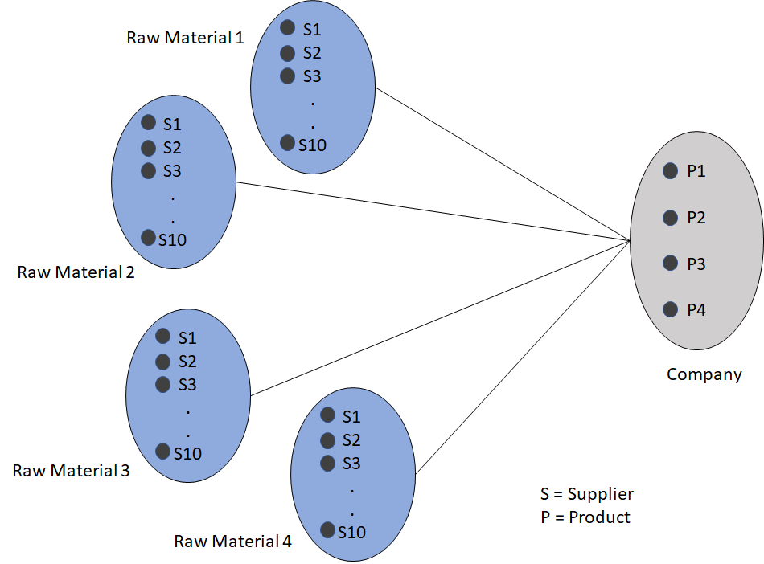
Model
FSC Model representation by graph

Slide 10
Solution
Variables
Demand
Logistic Cost
Output
Minimum cost and Lead time combination
Procurement quantity matrix for the combination

Slide 11
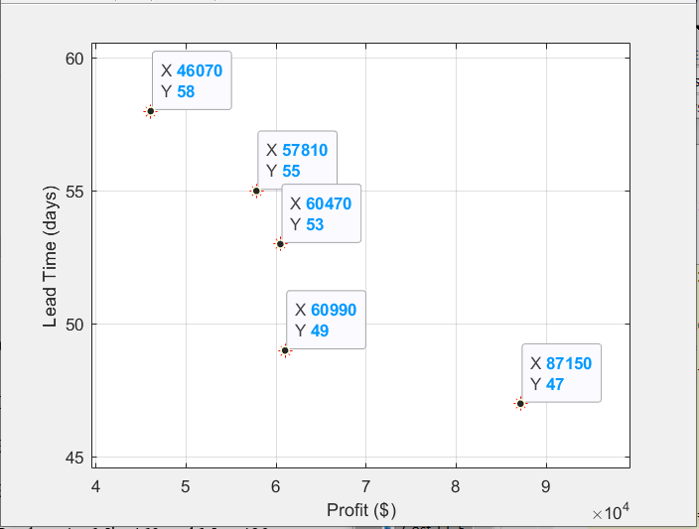
Sample Output 1
Pareto Solutions

Slide 12
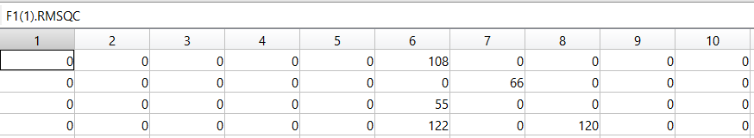
Sample Output 2
Raw Material Supplier Quantity Matrix

Slide 13
Future Scope
Extensive scenario simulations
Multi product multi echelon model
Product priority differentiation

Slide 14
References
K. Deb, A. Pratap, S. Agarwal, and T. Meyarivan, “A fast and elitist multiobjective genetic algorithm: NSGA-II,” IEEE Trans. Evol. Comput., vol. 6, no. 2, pp. 182–197, Apr. 2002, doi: 10.1109/4235.996017.
E. Bottani, T. Murino, M. Schiavo, and R. Akkerman, “Resilient food supply chain design: Modelling framework and metaheuristic solution approach,” Comput. Ind. Eng., vol. 135, pp. 177–198, Sep. 2019, doi: 10.1016/j.cie.2019.05.011.
Yarpiz, “NSGA-II in MATLAB,” Yarpiz, Sep. 01, 2015. https://yarpiz.com/56/ypea120-nsga2 (accessed Apr. 25, 2020).
H. Allaoui, Y. Guo, A. Choudhary, and J. Bloemhof, “Sustainable agro-food supply chain design using two-stage hybrid multi-objective decision-making approach,” Comput. Oper. Res., vol. 89, pp. 369–384, Jan. 2018, doi: 10.1016/j.cor.2016.10.012.
M. Musavi and A. Bozorgi-Amiri, “A multi-objective sustainable hub location-scheduling problem for perishable food supply chain,” Comput. Ind. Eng., vol. 113, pp. 766–778, Nov. 2017, doi: 10.1016/j.cie.2017.07.039.
M. Varsei and S. Polyakovskiy, “Sustainable supply chain network design: A case of the wine industry in Australia,” Omega, vol. 66, pp. 236–247, Jan. 2017, doi: 10.1016/j.omega.2015.11.009.

Slide 15
Thank You!

